Slide 1
ODE system

Slide 2
GF
Kon_1
Kon_2
Kon_3
+
GF-GFR
DGF-GFR
Endocytosis
Koff_1
Koff_2
GFR
Kcaton_4, Kdon_4
Fyn
Fyn_act
PTP
Kcatoff_4, kdoff_4
% Reaction flux
[gfr] = [gfr_total]-[gf_gfr]-2*[dgf_gfr];
[fyn] = [fyn_total]-[fyn_act];
v1 = kon_1[gf][gfr] – koff_1[gf-gfr]
v2 = kon_2[gf-gfr]^2 - koff_2[dgf-gfr]
v3 = Kon_3[dgf-gfr]
v4 = kcaton_4[dgf-gfr][Fyn]/(Kdon_4+[Fyn]) -kcatoff_4[PTP_total][Fyn_act]/(Kdoff_4+[fyn_act])
% Right hand sides
d[fyn_act]/dt = v4;
d[gf_gfr]/dt = v1-2*v2
d[dgf_gfr]/dt = v2 – v3
d[gfr_total]/dt = -2*v3

Slide 3
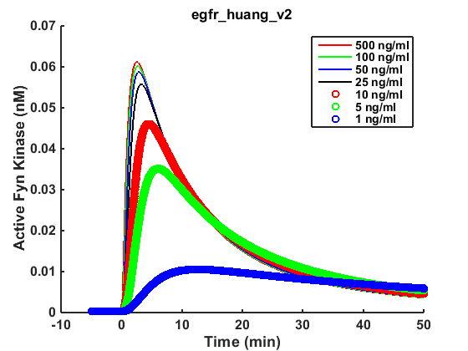
>> cd /Users/kathylu/Documents/sof/odesys/app
>> data = fyn_gf_init_data('egfr_huang_v2');
>> batch_fyn_gf(data);
>> data = fyn_gf_init_data('exp_hela_egf');
>> batch_fyn_gf(data);
Input data

Slide 4
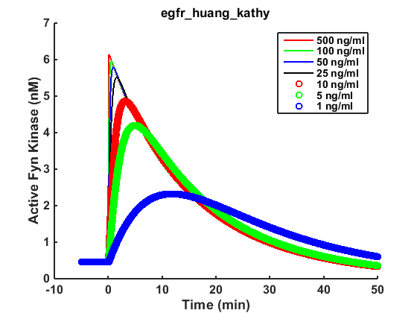
Input data

Slide 6
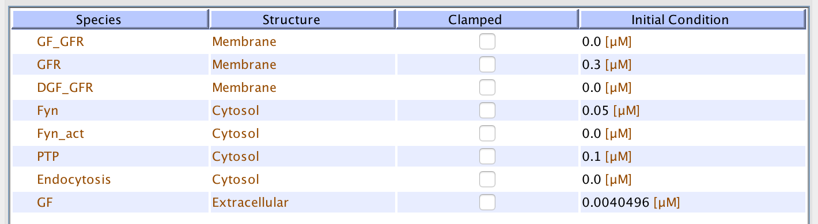

Slide 7
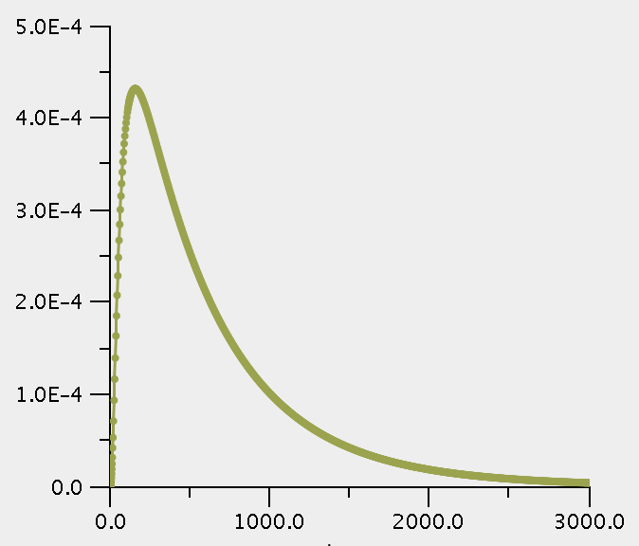
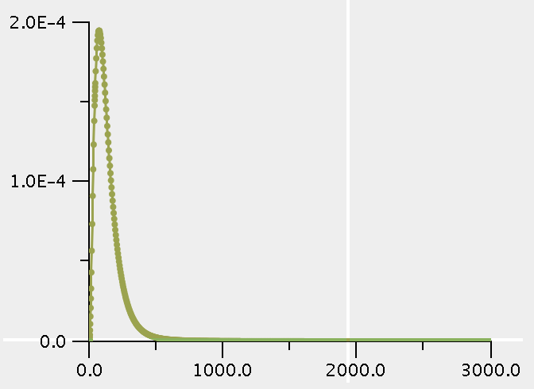
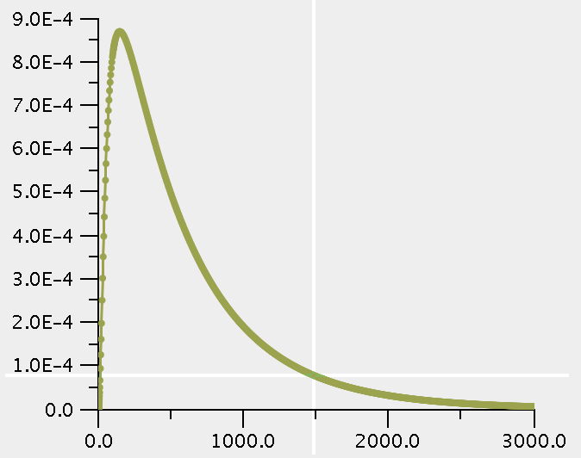
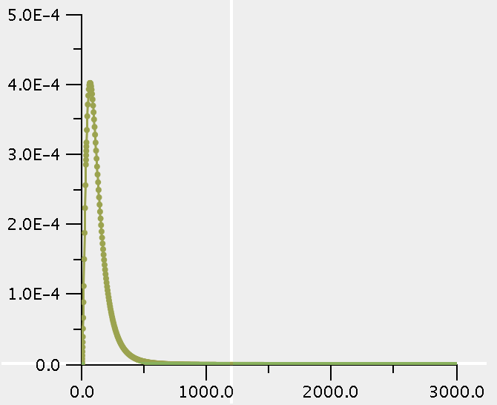
Simulations:
[egf] = 10 ng/ul
EGF_1 : 0.0001681 uM
EGF_5 : 0.0007766 uM EGF_10 : 0.0015316 uM
EGF_25: 0.0040496 uM
EGF_50 : 0.0080816 uM
EGF_100 : 0.0161466 uM
EGF_500 : 0.0806666 uM
[egf] = 25 ng/ul

Slide 8
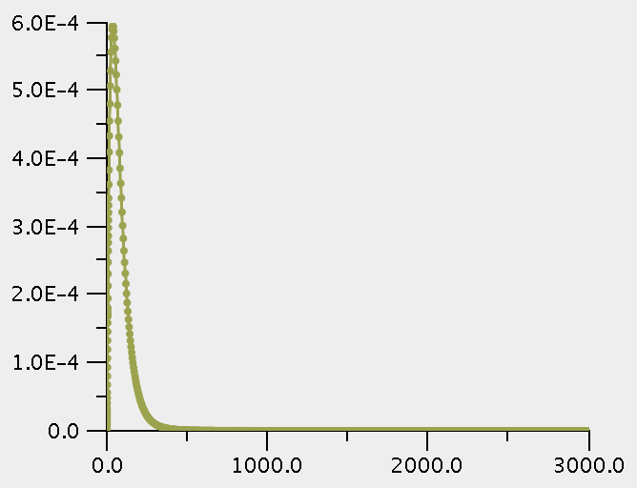
[egf] = 500 ng/ul
Conclusion: divide the concentration by 500.

Slide 9
Optimization (11/2/2019)
>> /Users/kathylu/Documents/sof/odesys/app/opt
>> test_optimize;
Solution 1:
-5.2813 4.6815 0.3299
Solution 2:
-0.8210 0.6696 0.7626

Slide 10
>> data = fyn_gf_init_data('egfr_huang_v3');
>> [t, y] = batch_fyn_gf(data);
>> [sol, error, t, y_exp, y_ode] = test_optimize_ode();
Initial [k_caton_4, k_catoff_4, k_on_3, scale, error] =
0.0100 0.0200 482.8571 0.2484
……
[k_caton_4, k_catoff_4, k_on_3, scale, error] =
1.0e+04 *
5.1870 7.4154 0.0671 0.0000

Slide 12
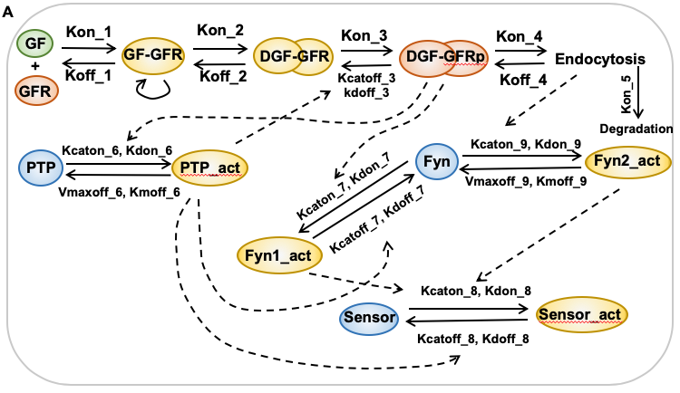

Slide 13
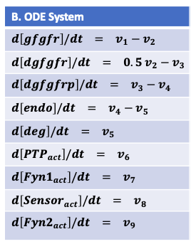

Slide 14
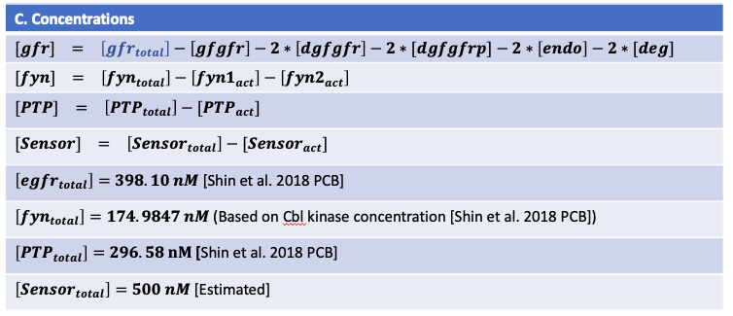

Slide 15
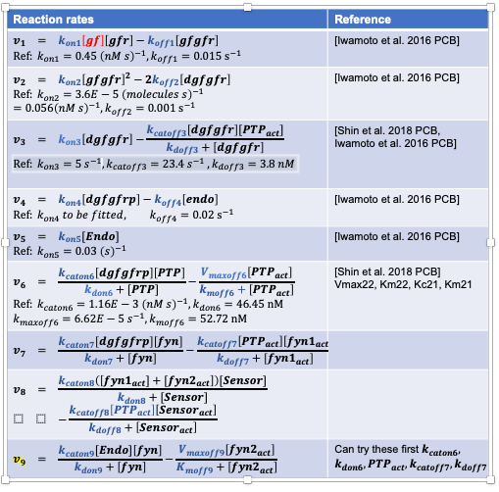

Slide 16
Implemented the complete fyn_gf_model and run a single simulation
>> model_egfr2 = fyn_gf_model();
>> [t, output]= fyn_gf_forward_solve(model_egfr2.data, 'test_basal_level', 0, 'show_figure', 1, ...
'rhs_function', model_egfr2.rhs, 'y0', model_egfr2.data.y0, 'ouput_function', model_egfr2.output);
function model_obj = fyn_gf_model()
model_obj.data = init_data();
model_obj.init_data = @init_data;
model_obj.rhs = @rhs;
model_obj.output = @output;

Slide 17
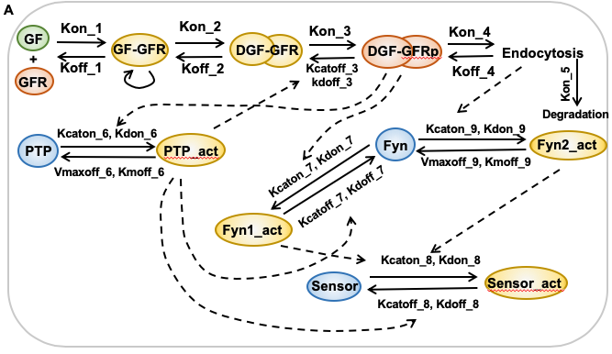
PTP does not de-activate Fyn
PTP de-activate Fyn

Slide 18
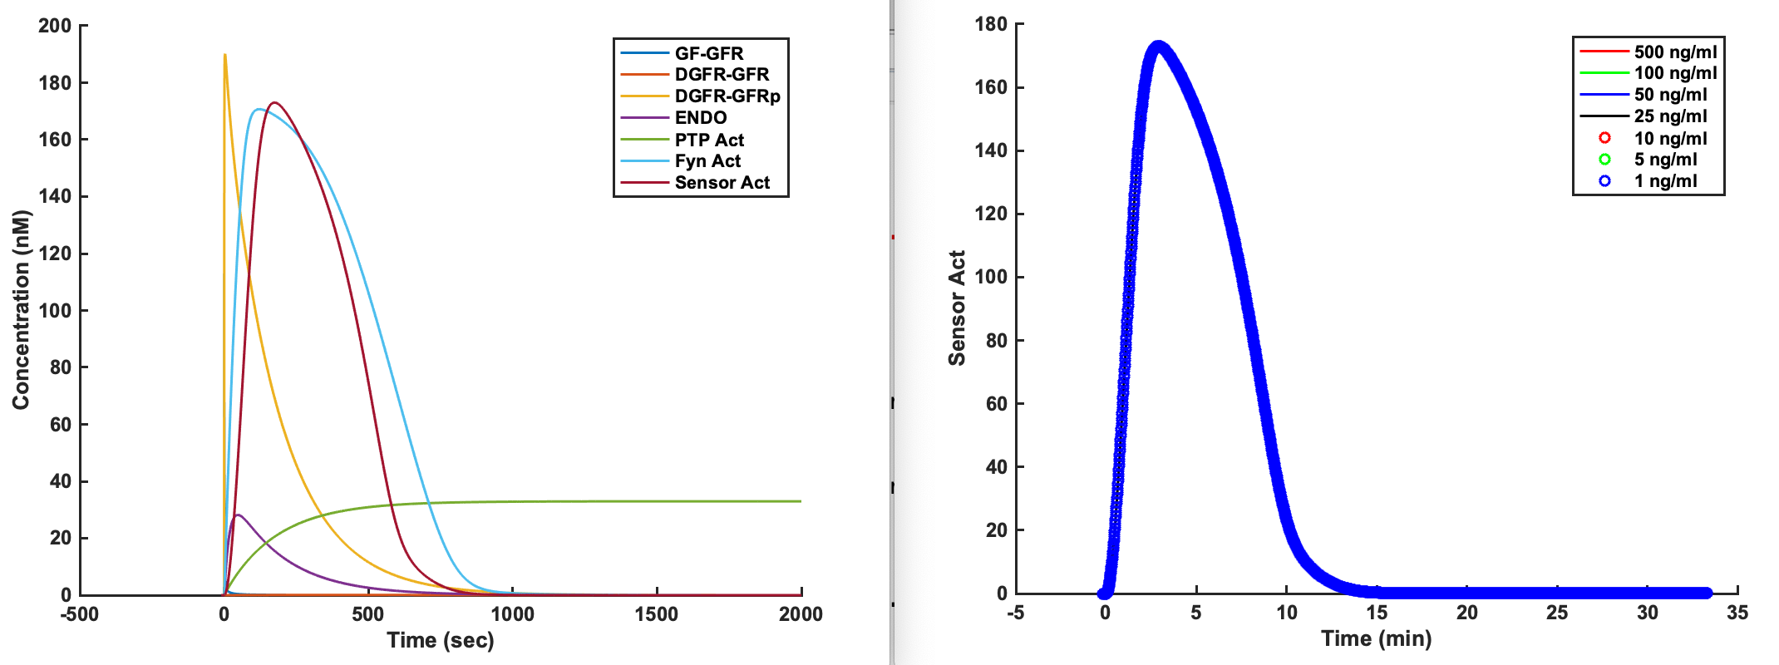
% test_odesys.m
% Run simulation of a complex model with initial parameters
>> model= fyn_gf_model();
>> [t, output]= fyn_gf_forward_solve(model.data, 'test_basal_level', 0, 'show_figure', 1, ...
>> 'rhs_function', model.rhs, 'y0', model.data.y0, 'output_function', model.output);
>> batch_fyn_gf(model.data, 'rhs_function', model.rhs, 'y0', model.data.y0, ...
'output_function', model.output);

Slide 19
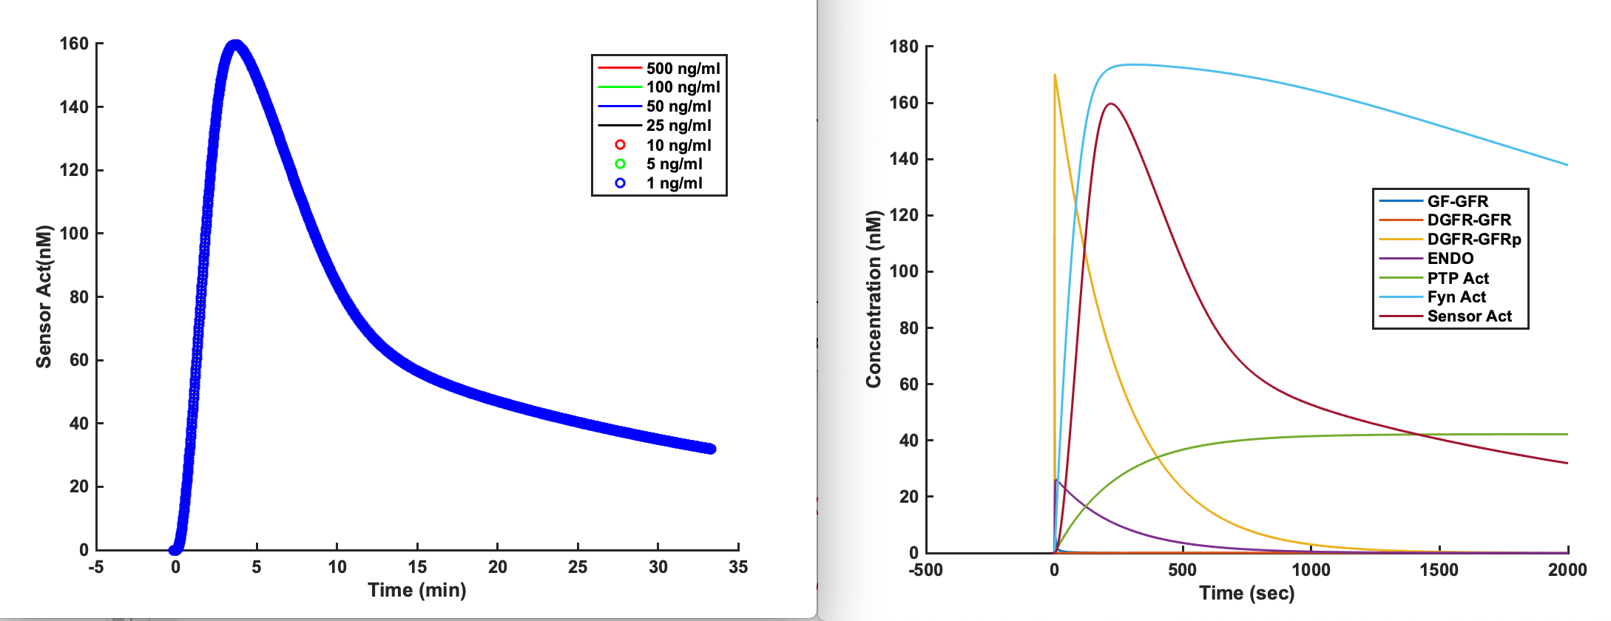
% test_odesys.m
% Run simulation of a complex model with best fit

Slide 20
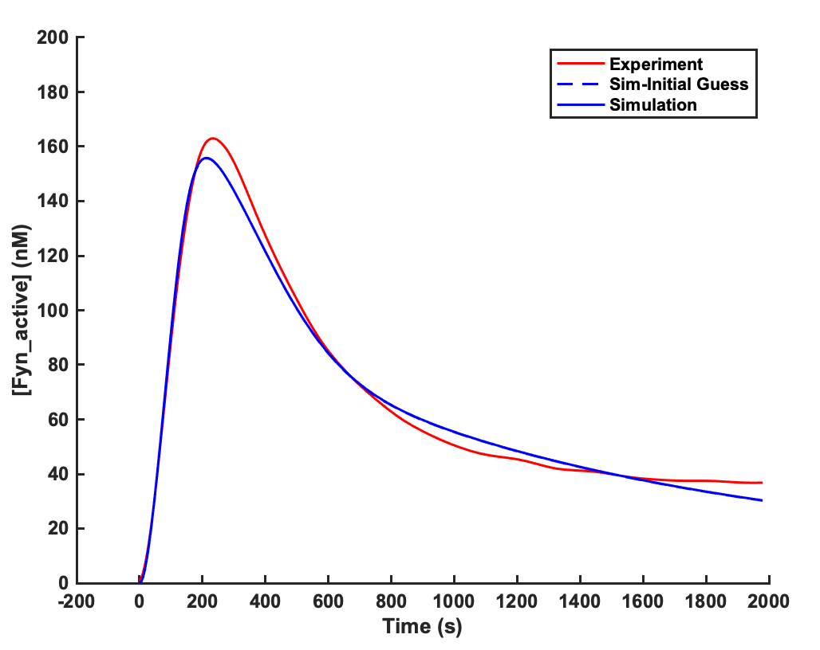
% test_ode_optimize.m
% Optimize the complex model
With Endo No Deg, 5 parameters
error = 0.276%
6 parameters, error = 0.0721%
Which biochemical parameters contribute to the difference in EGFR and PDGFR kinetics?
What kind of distribution does the best parameters have?

Slide 21
The complex ode with no degradation
data.kon_2 = 0.056000
data.kon_2 = 0.560000
data.kon_2 = 5.600000
data.kon_2 = 56.000000
data.kon_2 = 560.000000
data.kon_2 = 5600.000000
data.kon_2 = 56000.000000
The dimerization or binding kinetics of GFRs are not important
% test_odesys.m
% Section “Run the best fit complex-nodeg model with different parameter values in batch”

Slide 22
The complex ode with no degradation
data.koff_2 = 1.000000
data.koff_2 = 10.000000
data.koff_2 = 100.000000
data.koff_2 = 1000.000000
data.koff_2 = 10000.000000
data.koff_2 = 100000.000000
data.koff_2 = 1000000.000000
The disassociation rate of the growth factor dimers are important.

Slide 23
data.kon_4 = 0.000005
data.kon_4 = 0.000050
data.kon_4 = 0.000495
data.kon_4 = 0.004950
data.kon_4 = 0.049500
data.kon_4 = 0.495000
data.kon_4 = 4.950000
The endocytosis rate of the active growth factors are important.

Slide 24
The enzymatic activity and binding rate of the PTP are not important
data.kcatoff_7 = 0.000004
data.kcatoff_7 = 0.000039
data.kcatoff_7 = 0.000391
data.kcatoff_7 = 0.003907
data.kcatoff_7 = 0.039070
data.kcatoff_7 = 0.390700
data.kcatoff_7 = 3.907000
data.kdoff_7 = 0.497800
data.kdoff_7 = 4.978000
data.kdoff_7 = 49.780000
data.kdoff_7 = 497.800000
data.kdoff_7 = 4978.000000
data.kdoff_7 = 49780.000000
data.kdoff_7 = 497800.000000

Slide 25
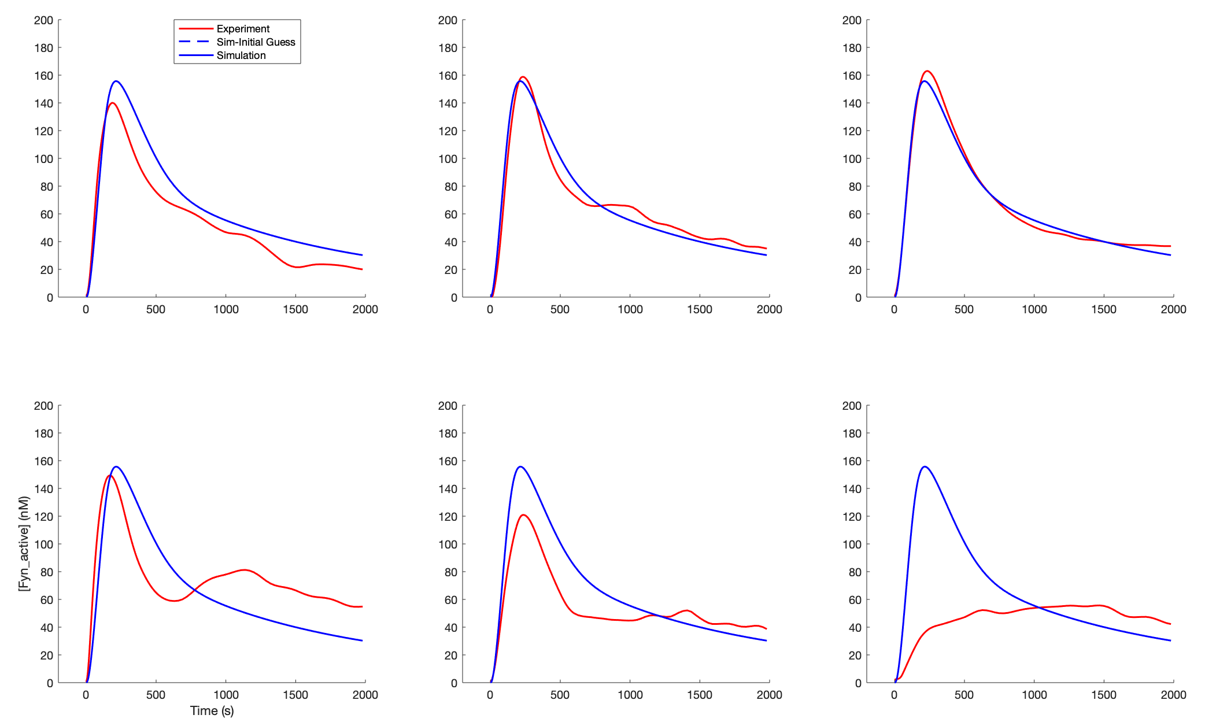
>> [sol0, sol] = optimize_solve('num_guess',0, 'model_name', 'complex_ode_nodeg');
model_obj.opt.index = (1:6)’; → something is wrong → try 6 and broke, debug later.
500 ng/ml 100 ng/ml
50 ng/ml
25 ng/ml 10 ng/ml 5 ng/ml

Slide 26

Another try on fitting concentration dependence
%% Optmize the complex model with no degradation and endocytosis of Fyn kinase
% fit concentration dependence
num_guess = 0;
model_name = 'complex_ode_nodeg_endo3'; % fyn_endo
[sol0, sol] = optimize_solve('num_guess',num_guess, 'model_name', model_name);
title('Complex ODE with no Degradation and Active Fyn Endocytosis');

Slide 27
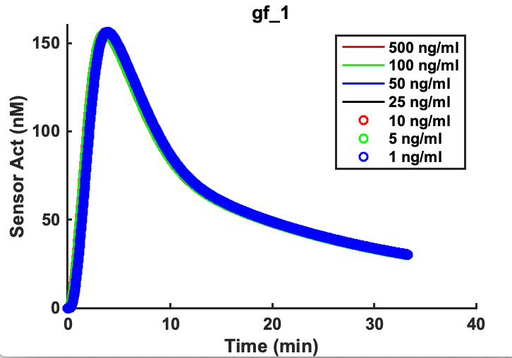
Next steps:
(1) fit concentration dependence
(2) fit with pdgf experiments.
Problem:
There is currently no concentration dependency.
Solution:
Probe the parameter that could change concentration dependency
Solution:
Probe the parameters that could change concentration dependency

Slide 28
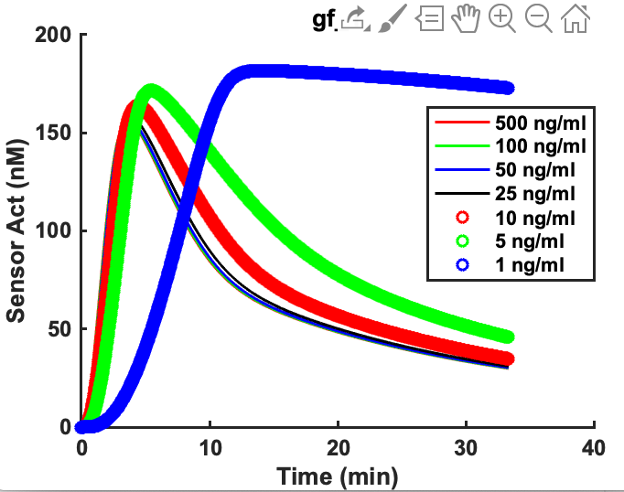
data.kon_1 = data.kon_1*1e-3;
data.koff_1 = data.koff_1*1e3;
All other parameters do not seem to affect the concentration dependence
Why are the AUC inversely related with [gf]?

Slide 29
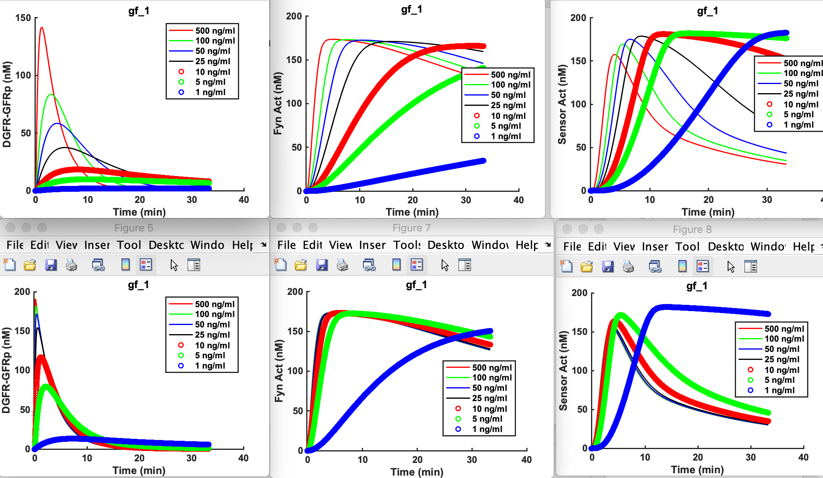
Plot intermediate species to find out the reasons.
data.kon_1 = data.kon_1*1e-3;
data.koff_1 = data.koff_1*1e3;
DGFR-GFRp seems to be good in concentration dependence.
→ We need to allow fyn_act to also endocytos

Slide 30
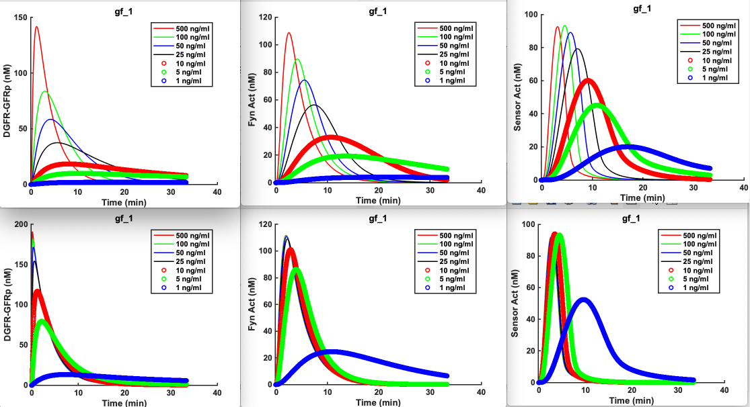
Run fyn_gf_model_nodeg() with fyn_endo set to 1
data.kon_1 = data.kon_1*1e-3;
data.koff_1 = data.koff_1*1e3;
Conclusion: koff_1 seems to be a better target parameter since kon_1 changes the activation speed of the kinase, which was not observed in the experiment

Slide 31
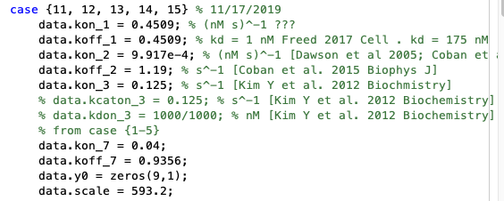
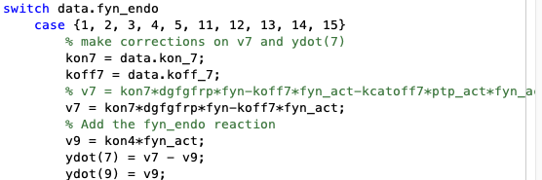
Made corrections to the model
Need to re-optimize “scale”
>> model = fyn_gf_model_nodeg('complex_ode_nodeg', 'best_fit', 1, 'fyn_endo', 11);
>> batch_fyn_gf(model.data, 'rhs_function', model.rhs, 'y0', model.data.y0, ...
'output_function', model.output);
First test run at 50 ng/ml

Slide 32
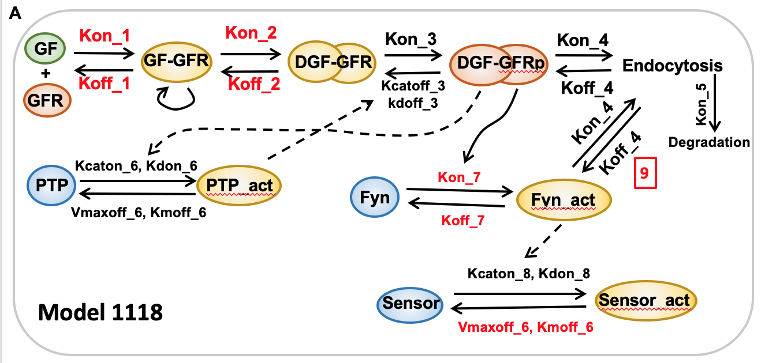
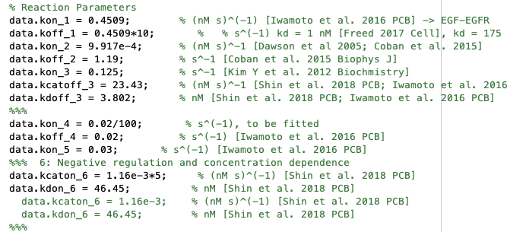
Model 1118
Estimated biosensor activation is 9.142% out of 200 nM, which is about 18.28 nM.

Slide 33
Concentration dependence
Multiple output
Good concentration dependence, but sensor and active fyn has a big difference.

Slide 34
Optimized a good set of parameters for single concentration

